Slide 1
LESSON 6.1b
Writing Exponential Models

Slide 2
Today you will:
Write exponential models to analyze real world situations.
Practice using English to describe math processes and equations

Slide 3
Core Vocabulary:
Exponential function, p. 296
Exponential growth function, p. 296
Growth factor , p. 296
Exponential decay function , p. 296
Decay factor , p. 296
Asymptote , p. 296
Previous:
Properties of exponents

Slide 4
Exponential Models (review)
Exponential equations/functions that reflect (model) real-world situations.
A common example is a value you are tracking that increases or decreases by a fixed percentage over a regular period of time (a year).
…where $a$ is the initial/starting value
$r$ is the rate of change … percent growth or decay
$t$ is the amount of time that has past
$(1+r)$ is the growth factor
$(1−r)$ is the decay factor

Slide 5
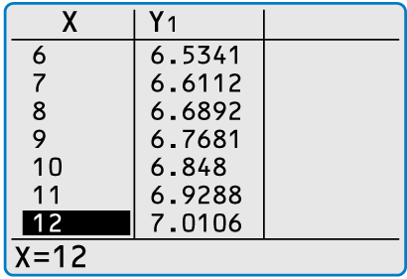
In 2000, the world population was about 6.09 billion. During the next 13 years, the world population increased by about 1.18% each year.
a. Write an exponential growth model giving the population y (in billions) t years after 2000. Estimate the world population in 2005.
b. Estimate the year when the world population was 7 billion.
SOLUTION
a. The initial amount is a $=$ 6.09, and the percent increase is r $=$ 0.0118. So, the exponential growth model is
y $=$ a(1 $+$ r)^{t}
Write exponential growth model.
$=$ 6.09(1 $+$ 0.0118)^{t}
Substitute 6.09 for a and 0.0118 for r.
$=$ 6.09(1.0118)^{t} .
Simplify.
Using this model, you can estimate the world population in 2005 (t $=$ 5) to be y $=$ 6.09(1.0118)⁵ $≈$ 6.46 billion.
b. Use the table feature of a graphing calculator to determine that y $≈$ 7 when t $=$ 12. So, the world population was about 7 billion in 2012.

Slide 6
Tell whether the function represents exponential growth or decay.
What is the rate of growth or decay?
$$y={(1.3)}^{x}$$
SOLUTION
$$y={(1.3)}^{x}$$
$b=1.3$ (greater than 1) so this is growth
$y={(1+.3)}^{x}$
Rewrite in $y={\left(1+r\right)}^{x}$ form, $r$ is the rate of growth
$$r=.3$$
The rate of growth is .3 or 30%.

Slide 7
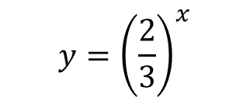
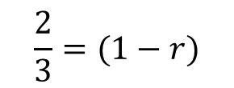
Tell whether the function represents exponential growth or decay.
What is the rate of growth or decay?
$$y={\left(\frac{2}{3}\right)}^{x}$$
SOLUTION
$$y={\left(\frac{2}{3}\right)}^{x}$$
$b=\frac{2}{3}$ (less than 1) so this is decay
Rewrite in $y={\left(1−r\right)}^{x}$ form, $r$ is the rate of decay
$$\frac{2}{3}=(1−r)$$
$$b=(1−r)$$
$$r=1−\frac{2}{3}$$
Solve for $r$
$$r=\frac{1}{3}$$
The rate of decay is $\frac{1}{3}$ or $.\overline{33}$ or 33%.

Slide 8
The amount y (in grams) of the radioactive isotope chromium-51 remaining after
t days is y = a(0.5)^{t/28}, where a is the initial amount (in grams). What percent of the
chromium-51 decays each day?
SOLUTION
y $=$ a(0.5)^{t/28}
Write original function.
$=$ a$\left[\text{(0.5)}\text{1/28}\right]$^{t}
Power of a Power Property
$\text{≈}$ a(0.9755)^{t}
Evaluate power.
$=$ a(1$−$0.0245)^{t}
Rewrite in form y $=$ a(1 $−$ r)^{t}.
The daily decay rate is about 0.0245, or 2.45%.

Slide 9
You deposit $9000 in an account that pays 1.46% annual interest. Find the balance
after 3 years when the interest is compounded quarterly.
SOLUTION
With interest compounded quarterly (4 times per year), the balance after 3 years is
A $=$ P$\left(\text{1}+\frac{\text{r}}{\text{n}} \right)\text{nt}$
Write compound interest formula.
$=$9000$\left(\text{1}+ \frac{\text{0.0146}}{\text{4}} \right)$^{4 • 3}
P = 9000, r = 0.0146, n = 4, t = 3
$≈$9402.21.
Use a calculator.
The balance at the end of 3 years is $9402.21.

Slide 10
Homework
Pg 300, #23-44

